Slide 1
Neuroscience & Behavior
(Chapter 3)
Ayesha Sheeraz

Slide 2
Neuropsychology
Neuropsychology is a branch of psychology that aims to understand how the structure and function of the nervous system and brain are related to specific psychological processes.
Many psychology programs use alternate names for this field, including biopsychology, physiological psychology, behavioral neuroscience and psychobiology.
Psychologists study the brain and the nervous system because all emotions, feelings, responses influences each other.

Slide 3
Why do psychologist study brain and nervous system
Because our brain is responsible for our emotions, behaviors, reactions, perceptions, cognitions, mood etc.
Since the brain is the command center of our whole body so its nature is very important in understanding behavior and mental processes
As Psychology is the study of human behavior and mental processes, so it makes sense

Slide 4
Biological basis of behavior
Nervous system
i-Central nervous system
ii-peripheral nervous system

Slide 5
Nervous system
Nervous system is an extensive network of specialized cells that carries information from one part to the other end/parts of the body
The nervous system is a complex network of cells that carry messages to and from the brain and spinal cord to various parts of the body.

Slide 6
Cont..
Playing a piano, driving a car, hitting a tennis ball, all at one level, depends on the exact muscle coordination
For the muscles to produce any meaningful physical activity, the brain has to provide the messages to the right area of the body
Such messages are passed through specialized cells called neuron

Slide 7
Cells of the nervous system
Neurons :The cells that make up the nervous system, including brain, is called neuron (nerve cell)
These specialized cells are the information-processing units of the brain responsible for receiving and transmitting information.
Approximately 1 trillion neurons throughout the body are involved in the control of behavior.

Slide 8
neuron
There are also several different types of neurons responsible for different tasks in the human body.
Sensory neurons carry information from the sensory receptor cells throughout the body to the brain.
Motor neurons transmit information from the brain to the muscles of the body

Slide 9
Structure of neurons
Most neurons have these components
Dendrites
A cell body
An axon
Axon ending (terminal buttons)

Slide 10
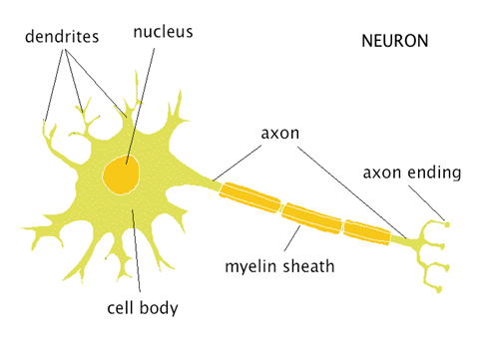

Slide 11
Dendrites
The term dendrites comes from a Greek word means “tree”.
branch like structure that receives
messages from other neurons
Receives information from other neurons and transmits it to the cell body

Slide 12
Soma / the cell body
The main portion of the cell is called the soma or cell body.
It contains the nucleus, which in turn contains the genetic material/information
Soma & nucleus are responsible for maintaining the life of the cells and keep the neuron functional.
The support structures of the cell include mitochondria, provides energy for the cell
Much of the metabolic work occurs here.

Slide 13
Axon
The axon is a long, slender tube, that carries the message to other cells.
axon is the “information sender” of the neuron,
The axon carries information from the cell body to the terminal buttons.
A neuron can have any number of dendrites, but it is limited to only one axon.
Some neurons have short axons, while others can be quite long.
The larger the axon, the faster it transmits information

Slide 14
Myelin sheath
Some axons are covered with a fatty substance called myelin sheath that acts as an insulator (protection of impulses).
These myelinated axons transmit information much faster than other neurons.
Increase the speed of information transmition

Slide 15
Axon end
Axons end in swollen, bulb like structure called terminal buttons.
The terminal buttons are located at the end of the neuron and are responsible for sending signals from the axon of one neuron to the dendrites of neighboring neurons.

Slide 16
Synapse
The space between the two neurons
Between the axon ending and the dendrite of the next neuron is a very tiny gap called the synapse (or synaptic gap, or synaptic cleft),
Information from one neuron flows to another neuron across a synapse in the form of electrical or chemical impulse.

Slide 17
Nervous System
Central Nervous System
Peripheral Nervous System

Slide 18
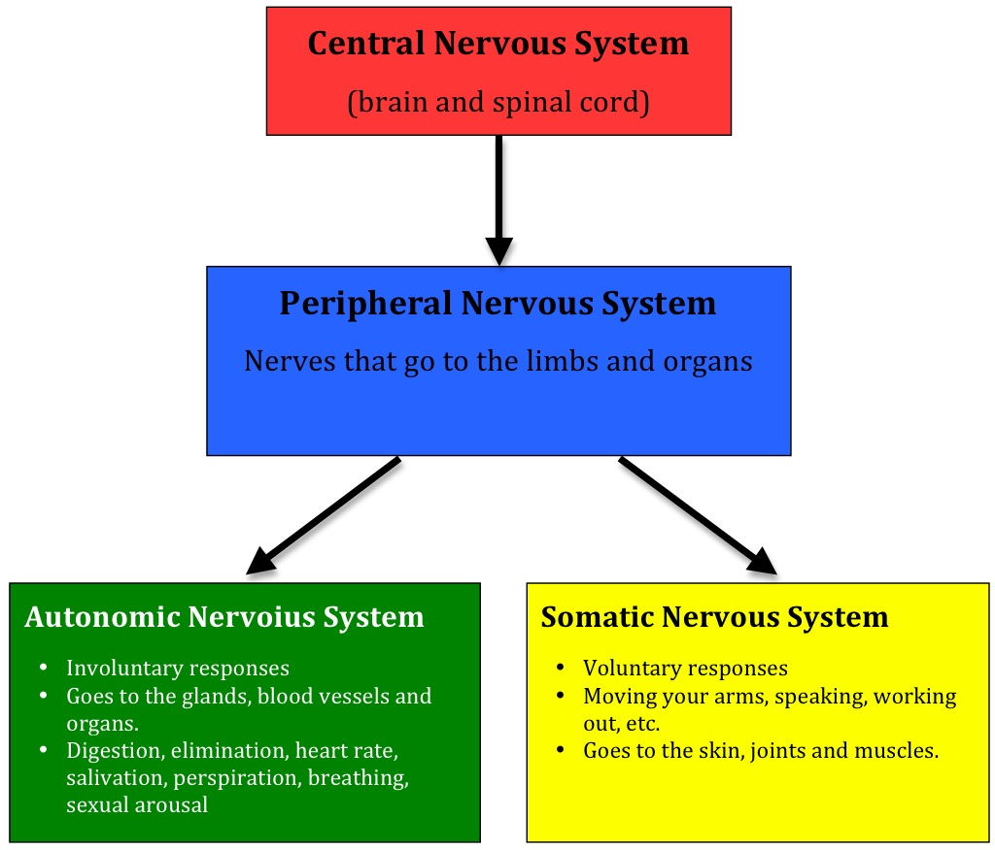
Nervous System

Slide 19
Cont..
Central nervous system
brain
spinal cord
Peripheral nervous system
Somatic
Autonomic

Slide 20
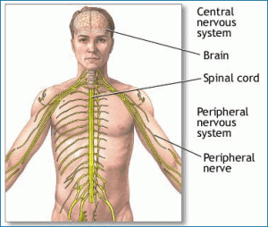

Slide 21
Central Nervous System
Spinal Cord
The portion of the central nervous system that is located in the spine and plays a role in communicating information between the brain and the peripheral nervous system
The extension of the brain
Bundle of neurons that leaves the brain and runs down the length of the back
The Main means for transmitting messages between the brain and the body

Slide 22
Brain
    The portion of the central nervous system that is located in the skull.
    It is most complex structure in the known universe.
    It is defined as a structure that contains billions of cells.
    Human brain is like one of the most powerful and sophisticated computers in the world.
    It plays important roles in sensation, movement and information processing.

Slide 23
PARTS
The three main parts of brain are
Fore brain
Mid brain
Hind brain

Slide 24
FORE BRAIN
  Cerebrum
  Thalamus
  Hypothalamus (Part of limbic system)

Slide 25
MID BRAIN
  Tectum
  Tegmentum
HIND BRAIN
  Cerebellum
  Pons
  Madulla

Slide 26
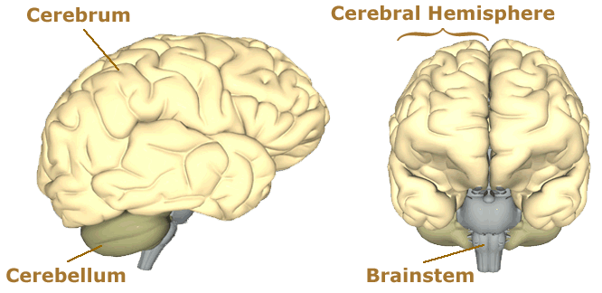
External Brain Structures

Slide 27
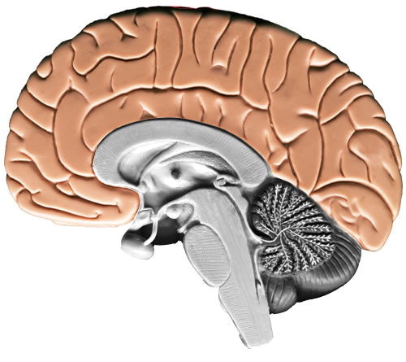
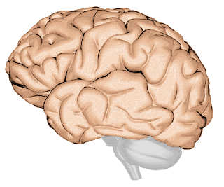
The Cerebrum
Cerebrum is the largest and most highly developed part of the human brain. It encompasses about two-thirds of the brain mass and lies over and around most of the structures of the brain.
It consists of two hemispheres that are connected together at the corpus callosum.
Left hemisphere controls the right side of the body and right hemisphere controls left side of the body
Corpus callosum

Slide 28
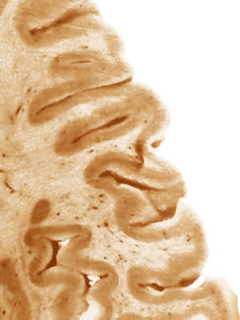
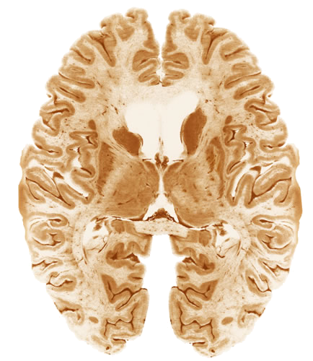
The Cerebrum
Neocortex
The cerebrum’s surface—the neocortex—is convoluted into hundreds of folds.
The neocortex is where all the higher brain functions take place.

Slide 29
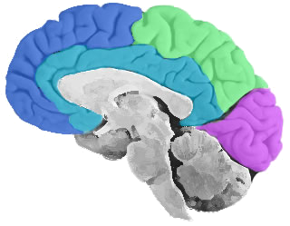
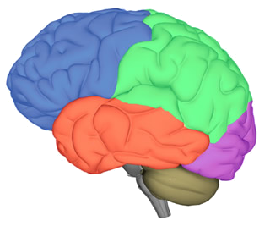
Lobes of the Cerebrum
Limbic Lobe
The cerebrum is often divided into five lobes that are responsible for different brain functions.
Frontal Lobe
Parietal Lobe
Occipital Lobe
Temporal Lobe

Slide 30
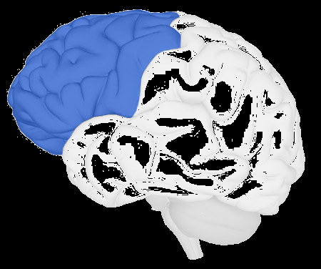
Frontal Lobe
The frontal lobe is the area of the brain responsible for higher cognitive functions.
These include:
Problem solving
Reasoning
Planning
Memory
parts of speech(Language0
Motivation
Judgment
Impulse control

Slide 31
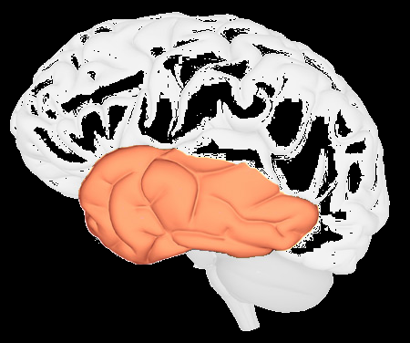
Temporal Lobe
Temporal lobes are located just above the ears. It is involved in hearing, language processing and memory.

Slide 32
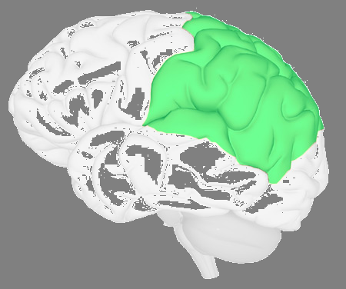
Parietal Lobe
The parietal lobe is located in the middle section of the brain and is associated with processing tactile sensory information such as pressure, touch, and pain.

Slide 33
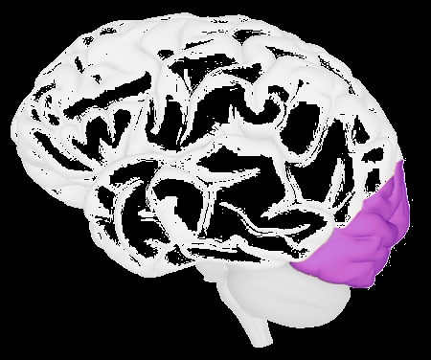
Occipital Lobe
The occipital lobe is located at the back of the brain and controls vision or visual process

Slide 34
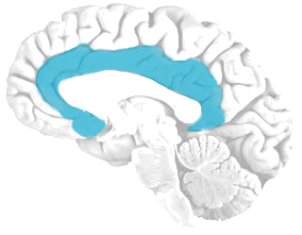
Limbic Lobe
The limbic lobe is located deep in the brain, and makes up the limbic system.

Slide 35
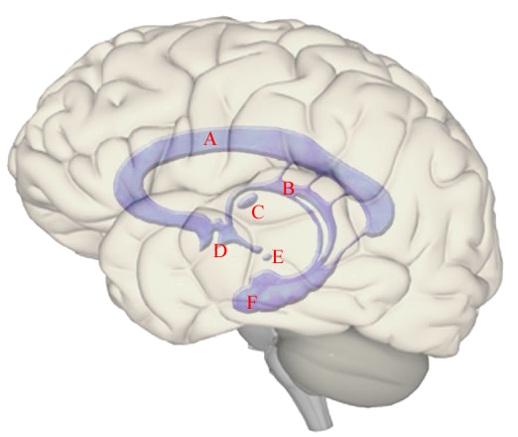
The Limbic System
The limbic system, often referred to as the "emotional brain", is found buried within the cerebrum.
The limbic system is the area of the brain that regulates emotion and memory, & motivation. It directly connects the lower and higher brain functions.

Slide 36
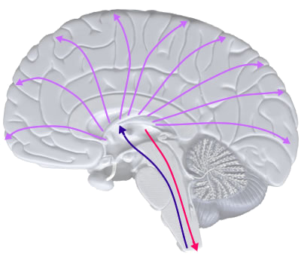
Thalamus
The thalamus is called the gateway to the cerebral cortex, as nearly all sensory inputs pass through it to the higher levels of the brain. It is a relay center for incoming and outgoing signals.
Organizes sensory information
Motor Control
Relays Sensory Signals to the Cerebral Cortex
Controls Sleep and Awake States

Slide 37
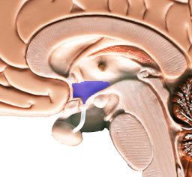
Hypothalamus
The hypothalamus sits under the thalamus. It responsible for regulating basic biological needs : hunger, thirst, temperature etc.

Slide 38
MID BRAIN
The midbrain is a portion of the central nervous system associated with vision, hearing, motor control(body and eye movement), sleep/wake, arousal (alertness), and temperature regulation.
The midbrain is located below the cerebral cortex, and above the hindbrain placing it near the center of the brain.
It has two parts.
Tectum
tegmentum

Slide 39
The tectum is responsible for auditory and visual reflexes/responces.
The tegmentum: floor of the mid brain
Controls Motor Functions
Regulates Awareness and Attention
Regulates Some Autonomic Functions

Slide 40
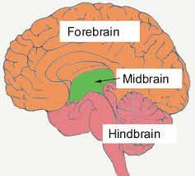
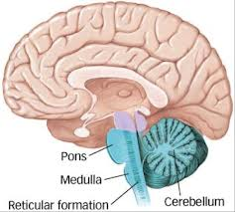
HIND BRAIN
The hindbrain is the structure that connects the spinal cord to the brain.

Slide 41
Cerebellum
The cerebellum is located at the base of the brain, just above the brain stem, where the spinal cord meets the brain, The cerebellum is connected to the brainstem, and controls motor movements, balance, coordination.
The cerebellum receives information from the sensory systems of the spinal cord, and other parts of the brain and then regulates motor movements.
It does not initiate movement rather the cerebellum coordinates voluntary movements such as posture, balance, coordination, and speech, resulting in smooth, balanced muscular activity.

Slide 42
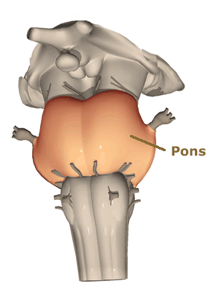
Pons
In Latin, the word pons literally means bridge
The pons is involved in several functions of the body including:
Arousal: waking from a sleep.
Controlling Autonomic Functions: respiratory movements , digestive processes
dreaming
Sleep

Slide 43
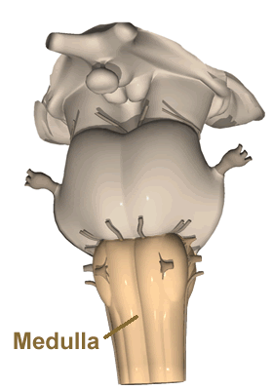
The Medulla Oblongata
The medulla oblongata is very smallest part of the brain, and is located directly above the spinal cord whose major function involves in involuntary reflex's
( heart rate, breathing, sneezing, coughing, blood pressure )
.

Slide 44
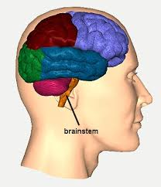
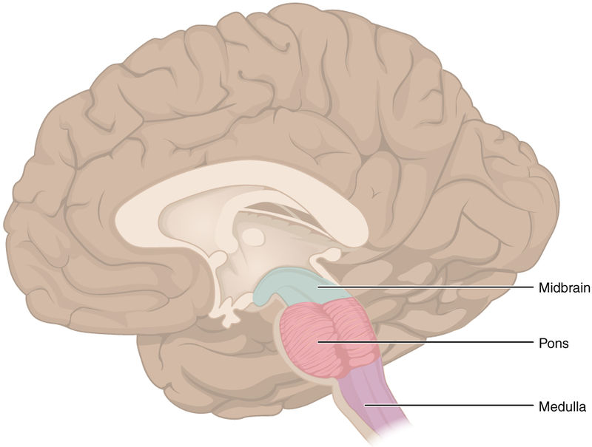
The Brainstem
Brainstem connects spinal cord and brain
It consists of Midbrain, pons, medulla oblongata
Motor and sensory neurons travel through the brainstem between the brain and the spinal cord
Peripheral nerves and spinal cord to the upper parts of the brain

Slide 45
Functions of the brain
It picked up all information from the environment by our sense organ and transmitted by many pathways of brain to the cerebral cortex.
Brain controls our muscular movements
Brain stores our memory
Brain does planning for us , plans for the future, thinks and reasons creatively.
Brain produce our emotions.

Slide 46
Peripheral Nervous System
The peripheral nervous system (PNS) is the division of the nervous system containing all the nerves that lie outside of the central nervous system (CNS).
The primary role of the PNS is to connect the CNS to the organs, limbs and skin.
These nerves extend from the central nervous system to the outermost areas of the body.

Slide 47
The peripheral nervous system is divided into two parts:
The somatic nervous system
The autonomic nervous system

Slide 48
The somatic nervous system
It carries information to CNS and motor information from the brain and spinal cord to muscles fibers throughout the body
It basically controls voluntary body movement

Slide 49
Autonomic Nervous System
The autonomic system is the part of the peripheral nervous system responsible for regulating involuntary body functions, such as blood flow, heartbeat, digestion and breathing

Slide 50
AUTONOMIC NERVOUS SYSTEM
The sympathetic and the parasympathetic nervous system are parts of what is commonly called the autonomic nervous system. (Autonomic = can not be controlled by the mind).
The sympathetic nervous system has an active "pushing" function, the parasympathetic has mainly a relaxing function.

Slide 51

Endocrine System

